Slide 1
3D Fitting Programs
Bulk sample fit for diffusion length
Bulk sample spatially resolved diffusion length
Fit3D
SpatialFit3D
Semilog plot of multiple sets of
intensity data
Plot Distribution

Slide 2
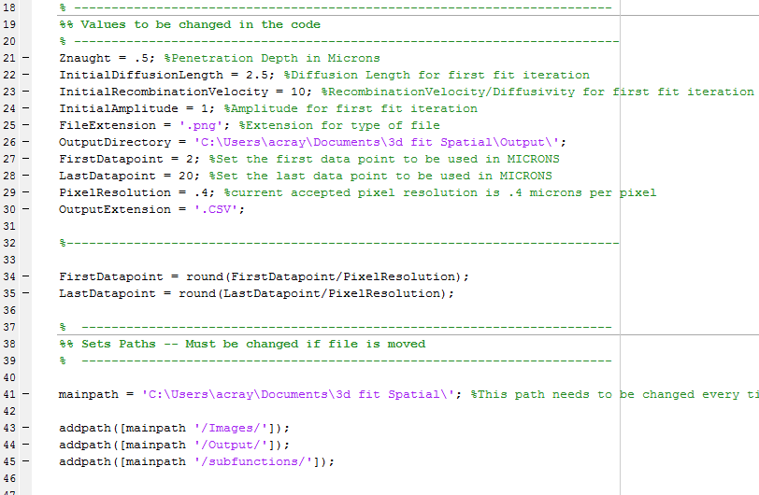
Fit3D
Fit3D finds the average diffusion length along the length of a linescan
Change the relevant values
here. The OutputDirectory
value needs to be changed
every time the file is moved.
The mainpath variable needs to be redefined each time the file is moved to a new folder
After making the listed adjustments, run the program. The program will prompt all necessary inputs.

Slide 3
Fit 3D continued
Flow of program:
Program prompts the name of file to be analyzed, and the name of the background file for background subtraction.
The user is prompted for the output file name. The data will be in a file with this name.
The line can be cut as many times as needed. NOTE: do not specify 0:number, write 1:number instead. Entering 0 as the start point will crash the program.
The program will perform the fit and a picture of the fit graph will be saved.
Combination with Plot Distribution:
The program Plot Distribution can only be used after this program has been run. This program outputs the .CSV file which Plot Distribution then graphs.

Slide 4
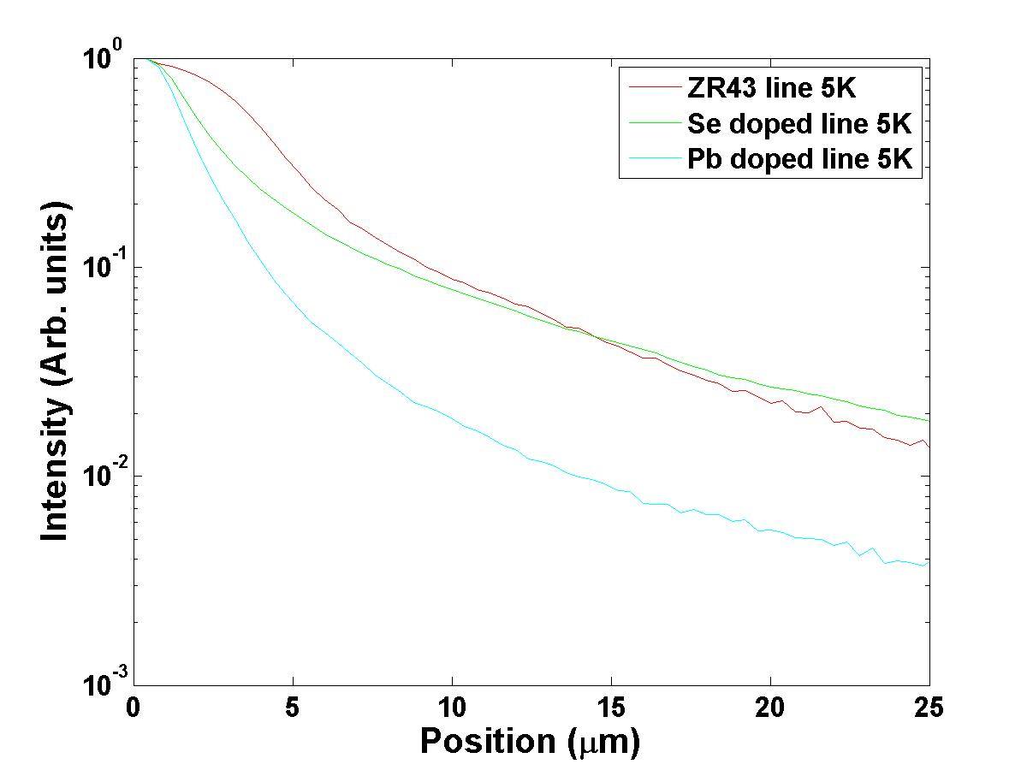
PlotDistribution
Creates a plot of the intensity data from multiple line scans.
(Remember to change necessary values at the top of the code)
Product of the program:
The desired linescan files must first be loaded with the Fit3D program. The Fit3D program creates a .CSV file with the data necessary to make the graph.
The PlotDistribution program will then prompt you to select which files to load.
After loading the desired number of files, press enter, or tell the program to stop loading files
Note that the y-axis has a logarithmic scale

Slide 5
SpatialFit3D
Fit3D finds the diffusion length at each point along the length of a linescan
Change the relevant values
here. The OutputDirectory
value needs to be changed
every time the file is moved.
The mainpath variable needs to be redefined each time the file is moved to a new folder
After making the listed adjustments, run the program. The program will prompt all necessary inputs.

Slide 6
SpatialFit3D continued
Flow of program:
Program prompts the name of file to be analyzed, and the name of the background file for background subtraction.
The user is prompted for the output file name. The data will be in a .CSV file with this name.
The line can be cut as many times as needed. NOTE: do not specify 0:number, write 1:number instead. Entering 0 as the start point will crash the program.
The program will perform the fit. After the diffusion length has been found for a certain point, it will write the information to the output .CSV file.
Important Notes:
The default number of points to perform the rolling average on is 5. This can easily be changed in the first chunk of code.
Closing the window showing the best fit line as it is being fitting will crash the code.
Because the output data is written into the file line by line as each fitting loop ends, stopping the program early will KEEP data that has already been produced. You will have the data that has already been created if you stop it early.

